Slide 1
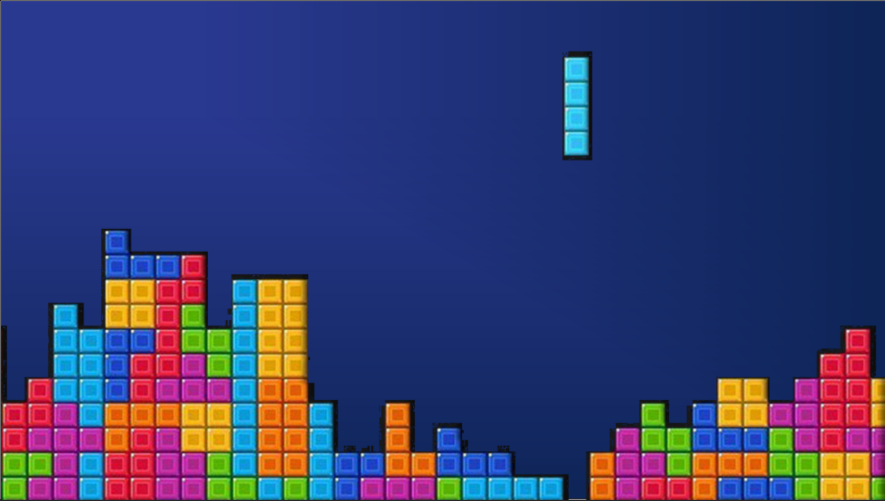
Group 14 - Tetris
Group 14 - Tetris
Benjamin Winiarski, Chloe Bi, Jamie Hepburn,
Mai Phuong Ho, Pablo Bonilla and Anastasia Birrell
Benjamin Winiarski, Chloe Bi, Jamie Hepburn,
Mai Phuong Ho, Pablo Bonilla and Anastasia Birrell

Slide 2


Motivation
Strained Eyes
difficulty concentrating
sensitivity to light
headache
Eugene M. Helveston, Visual Training: Current Status in Ophthalmology, American Journal of Ophthalmology, Volume 140, Issue 5, 2005, Pages 903-910, ISSN 0002-9394, https://doi.org/10.1016/j.ajo.2005.06.003
Notes:
As a group, we decided our main motivation was to provide a fun and engaging activity that allowed users to relax strained eye issues that come from overusing screens. We aimed to use the tools we each had from each of our disciplines to create clean signals and effective machine learning models, and then work creatively to combine our skills to make a high-quality game. Finally, we've come up with the Tetris, a game is controlled using eye movements as the inputs.
And here is how our awesome team have developed this product.

Slide 3
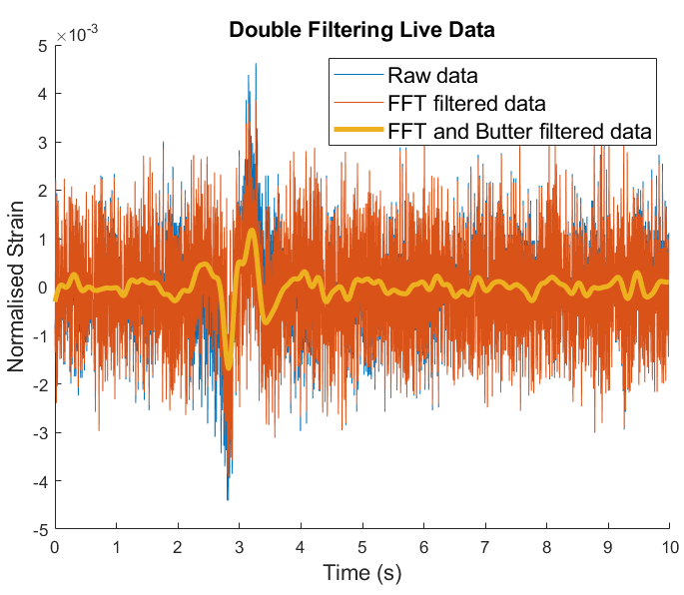
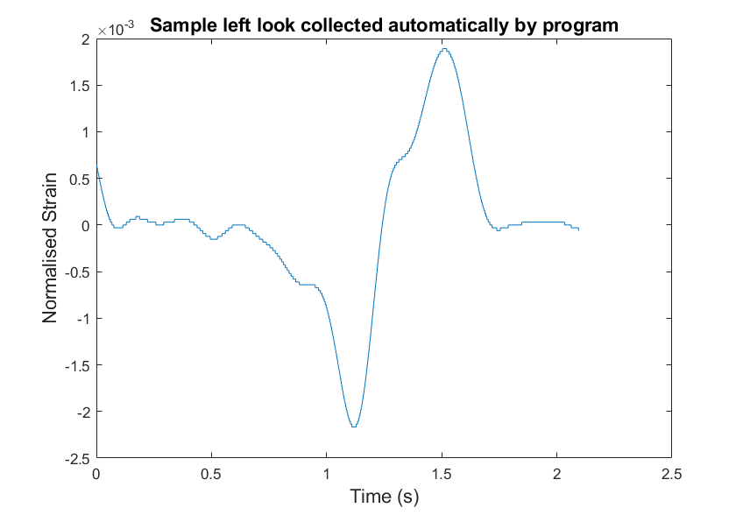
Method - Event Identification / Data Collection
Clean, Fast and Robust data collection pipeline.
10s calibration
Double Filtered: FFT and butter filter
Automatic signal detection and storage
Over 1000 signals collected to train the models
Fed to trained model in R
Data Input
Automatic Detection and Truncation around Signal
Data Filtered

Slide 4
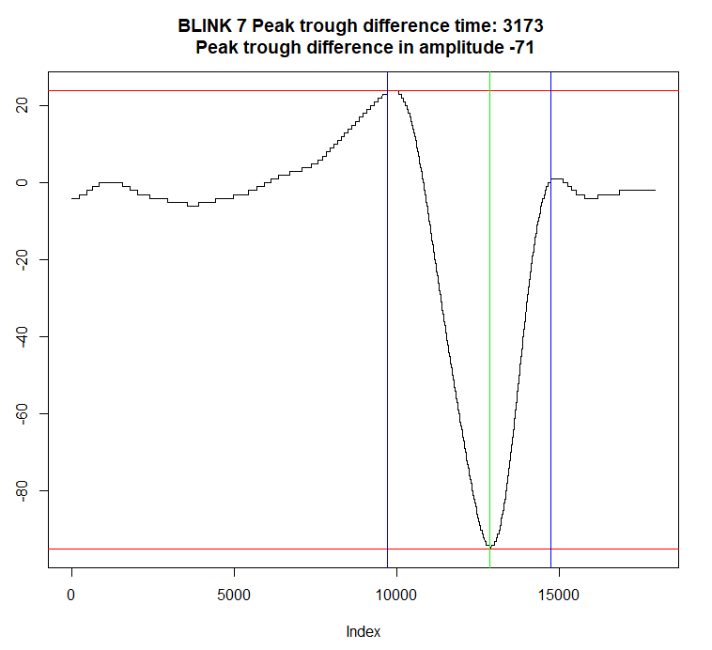
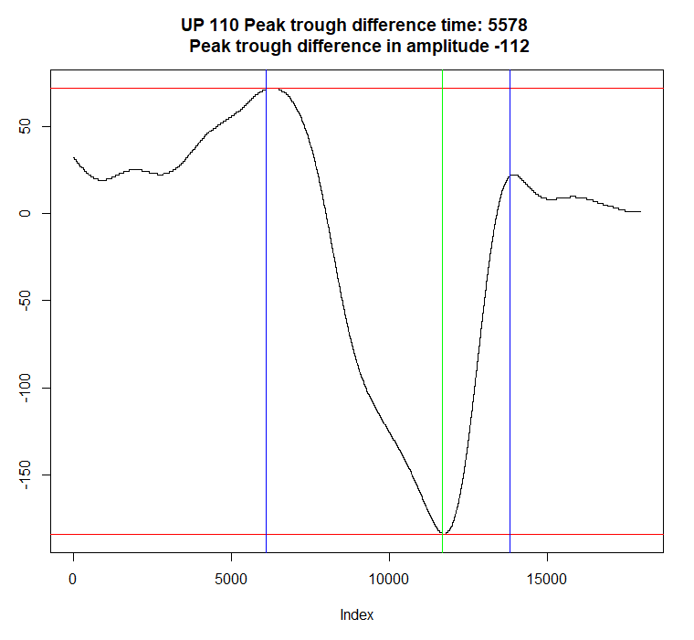
Method - Feature Creation and Selection
3. Amplitude between peak and trough
4. Whether first peak was larger than the second peak
5-8. Minimum, maximum, mean, variance
1. Time between peak and a trough
2.Time between two peaks
See appendix for DOWN, LEFT, RIGHT signals

Slide 5
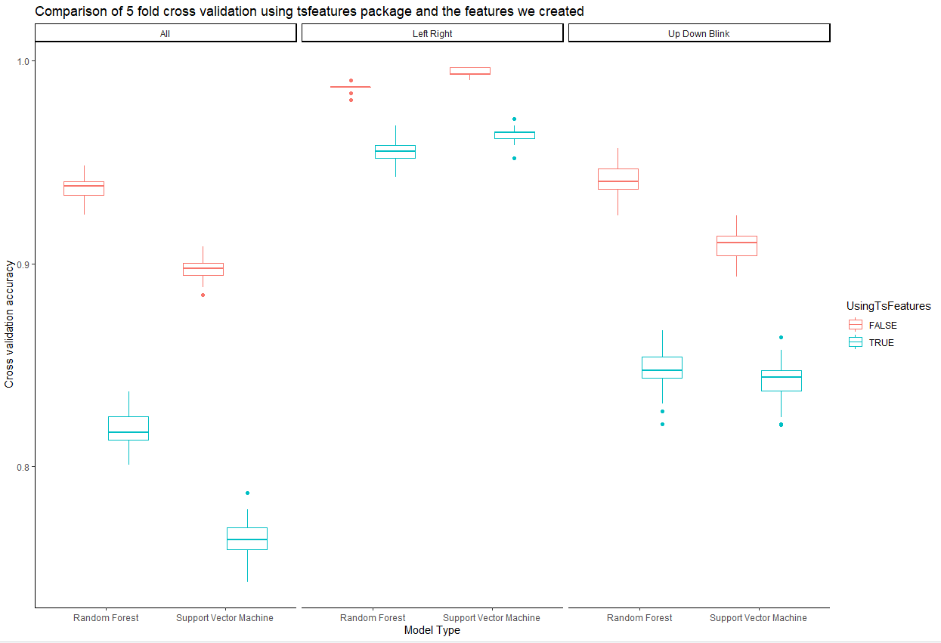
Method - Model Selection
98%
99%
Better overall accuracy for both classifiers with our features!
Time reduced from 2.02 seconds per wave to 0.26 seconds per wave
Random forest has higher overall accuracy
94%
94%
91%
90%
Cross Validation Accuracy
Model Type

Slide 6
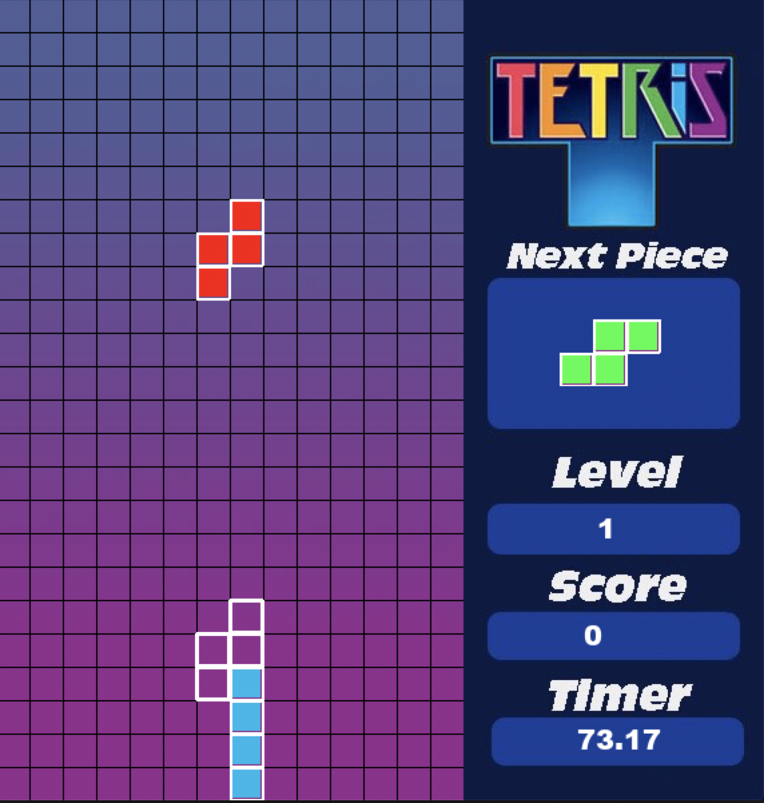
Method - Application
A Tetris game built with Python module ‘Pygame’.
The game reads instructions (txt string) as input from the Classification Model in R.
We can move pieces by:
Mode 1
Left - Looking Left
Right - Looking Right
Rotate - Blink
Mode 2
Left - Looking Down
Right - Looking Up
Rotate - Blink

Slide 7
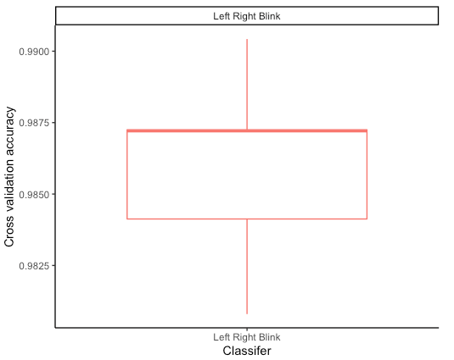
Performance of Left, Right, Blink Classifier
Results of 5-Fold Cross Validation on Training Data
Results of Testing Live Signals in Production
96% Accuracy
Results of Testing Live Signals in Production (Out of Sample Testing)
92% Accuracy
98% Accuracy

Slide 8
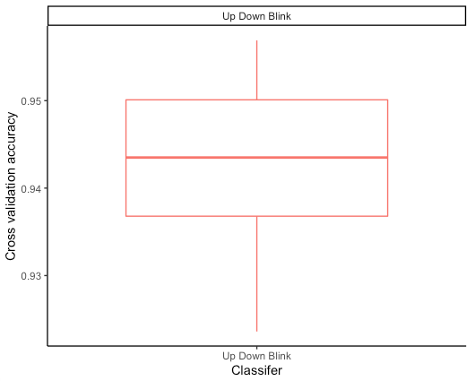
Performance of Up, Down, Blink Classifier
Results of 5-Fold Cross Validation on Training Data
Results of Testing Live Signals in Production
94% Accuracy
94% Accuracy

Slide 9
Speed of Production System
Time taken for model to classify a wave signal in training environment
0.1 - 0.2 seconds
Lag Time from the initial eye movement to Tetris piece movement in the live streaming environment
2 - 2.5 seconds

Slide 10
Discussion
Product performs very strongly and robustly in production
Data is double filtered in real time, potential signals are saved for prompt classification
Classifiers have high performance scores across environments
Lag times in game play are reasonable
Multiple game modes will keep users interested
Potential improvements
Boosting performance of the classifier involving all 5 movements
Integrating everything into python
Calibration for out of person testing

Slide 11
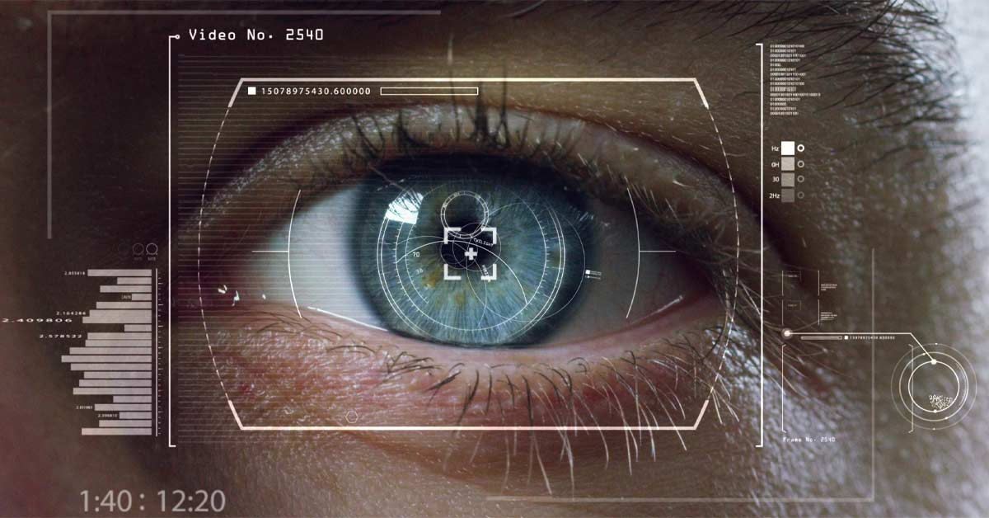
Conclusion
Avenues for further research
Tailor the game to individual eye disorders according to training regimes
Develop more games that can use all 5 eye movements, or tools like keyboards for those with a disability (Belkacem et al. 2014)
Achieved our goal of developing a high standard game
Worked efficiently in an interdisciplinary group setting
Walley, B. (2020, April 16). The Basics of Sport Vision Training with Dr. Brandon Walley. Retrieved from https://simplifaster.com/articles/sport-vision-training-dr-brandon-walley/

Slide 12
References
Benáček, P. (2017). benycze/python-tetris. Retrieved 20 May 2020, from https://github.com/benycze/python-tetris
Pete Shinners (2011). PyGame - Python Game Development. Retrieved from https://www.pygame.org/news
Gurevich, D. (2017). davidgur/Tetris. Retrieved 20 May 2020, from https://github.com/davidgur/Tetris
Walley, B. (2020, April 16). The Basics of Sport Vision Training with Dr. Brandon Walley. Retrieved from https://simplifaster.com/articles/sport-vision-training-dr-brandon-walley/
Belkacem, Abdelkader Nasreddine & Yoshimura, Natsue & SHIN, DUK & Kambar, Hiroyuki & Koike, Yasuharu. (2014). Eye-movement-based Communication System: A Comparison between Classification of Eye Movements Using EOG and EEG Sensors. 10.13140/RG.2.2.18705.63844.

Slide 13

LIVE DEMO
Left, Right and Blink mode
Up, Down and Blink mode
Surprise…

Slide 14
Pre-recorded Demo (if necessary)
https://drive.google.com/open?id=1HZ5tjjftfmzqabYGaTxoDCZwlFiyyL48

Slide 15
QUESTIONS

Slide 16
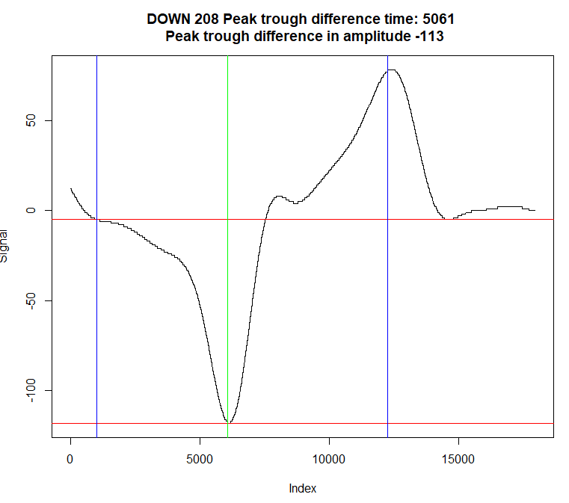
Appendix
DOWN SIGNAL
Blue lines indicating where a peak is detected relative to a trough in green
Red lines indicating the amplitudes of first peak and trough

Slide 17
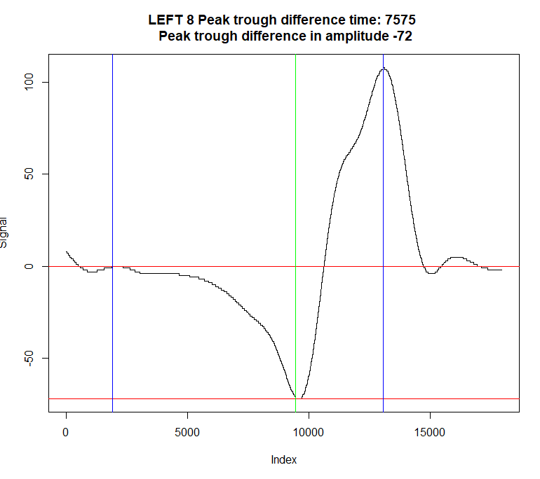
Appendix
LEFT SIGNAL
Blue lines indicating where a peak is detected relative to a trough in green
Red lines indicating the amplitudes of first peak and trough

Slide 18
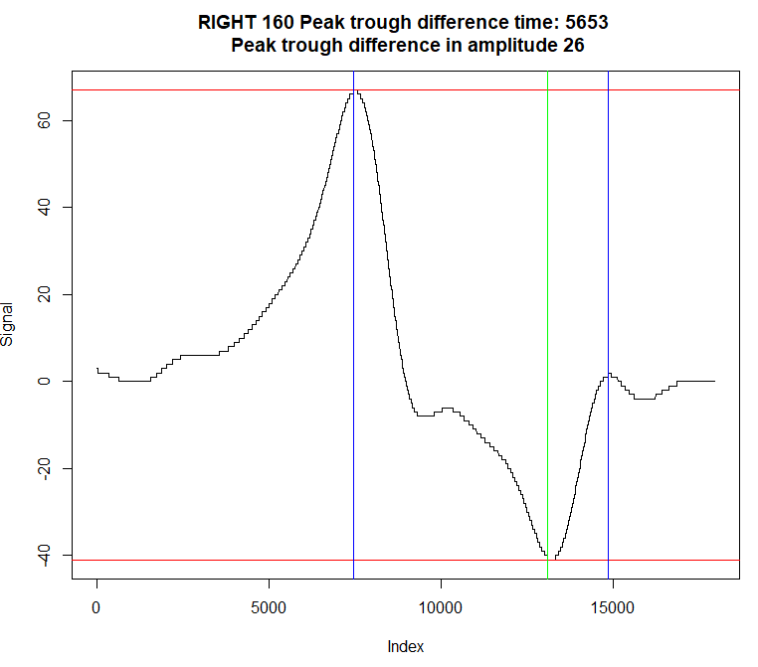
Appendix
RIGHT SIGNAL
Blue lines indicating where a peak is detected relative to a trough in green
Red lines indicating the amplitudes of first peak and trough

